Slide 1
CREATING SOIL MAPS FOR SSURGO-SQLITE DATABASES
Steve Peaslee
2021-07-20

Slide 2
This version of the ‘Soil Data Development for SQLite’ ArcToolbox only works with ArcMap using a set of experimental SSURGO-SQLite databases. These databases were created using a second, experimental ArcToolbox that is already ArcGIS Pro compatible and incorporates Spatialite commands. Currently the coordinate system for all spatial layers are Geographic WGS 1984 (EPSG 4326) which matches the original SSURGO shapefiles.
Compared to the previous version for gSSURGO, there is a lot less code that is ArcMap-dependent, but it is still a significant issue. There is also the issue of migrating the code from Python 2.7 to Python 3.7, but this should be a straight-forward process.
Another significant change is the addition of an option to exclude ‘dry organic surface horizons’ from the aggregation.
My intention is to migrate this tool to ArcGIS Pro as soon as the aggregation code has been successfully tested and the results compared with Web Soil Survey. This information is current as of July 20, 2021, but the tools are still under development and subject to change.

Slide 3
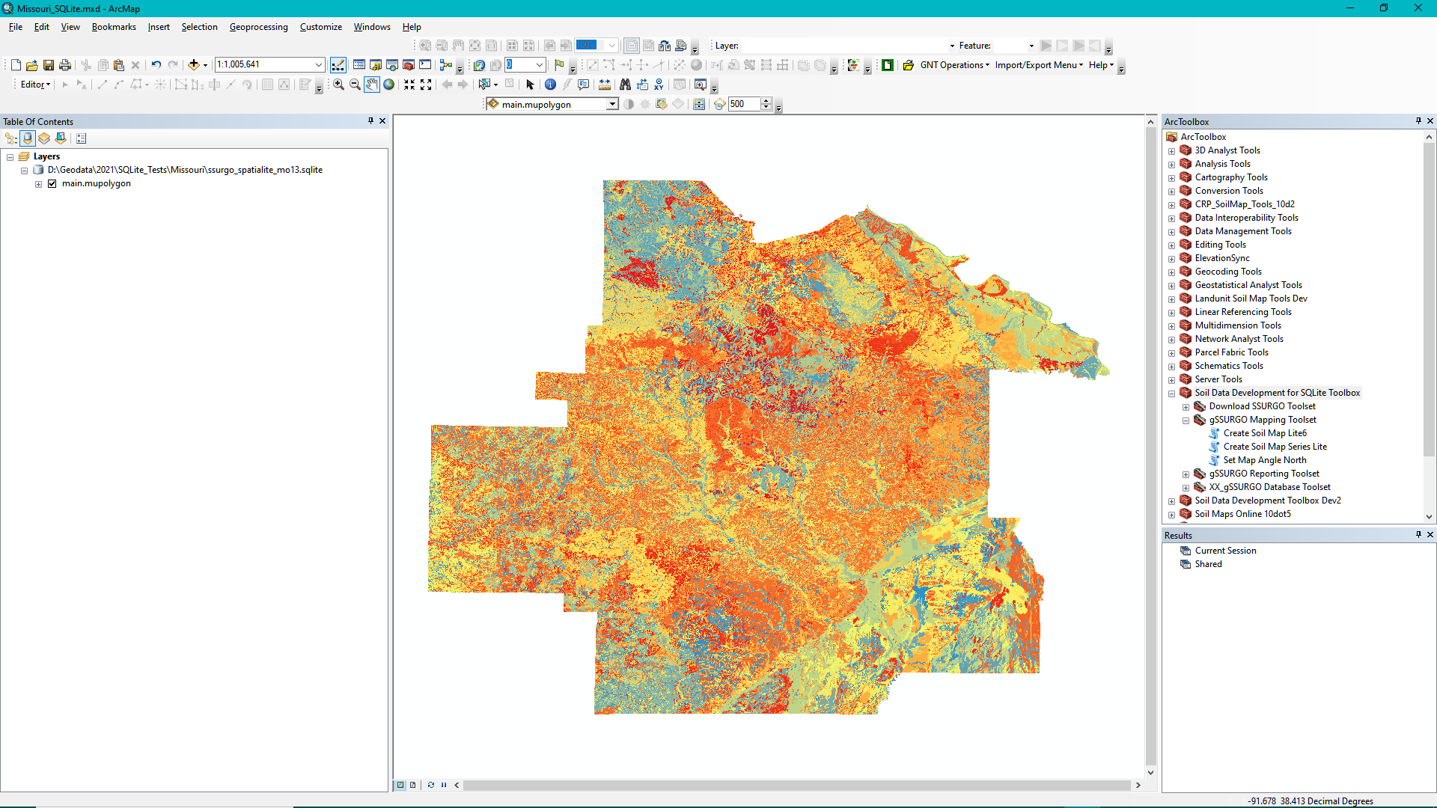
Two ArcTools are highlighted in this document: ‘Create Soil Map Lite’, ‘Create Soil Map Series Lite’

Slide 4
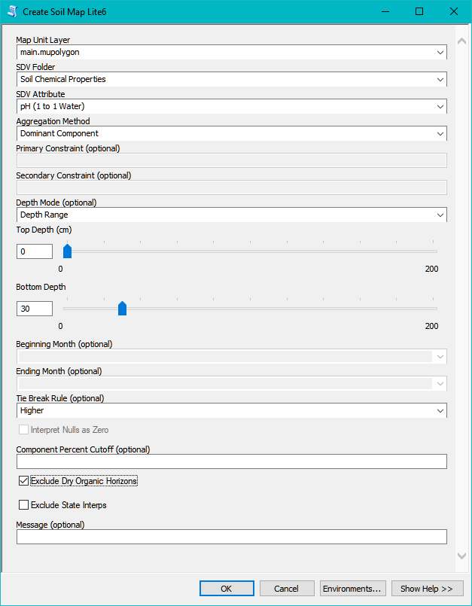
There have been a couple of changes in the ‘Create Soil Map’ tool and menu.
Checking the new option to ‘Exclude Dry Organic Horizons’ will cause the aggregation process to ignore surface horizons that consist of dry organic matter.
Another change is the addition of the ‘Depth Mode’ option. This change is rather minor and is designed to bring the interface into better alignment with Web Soil Survey.

Slide 5
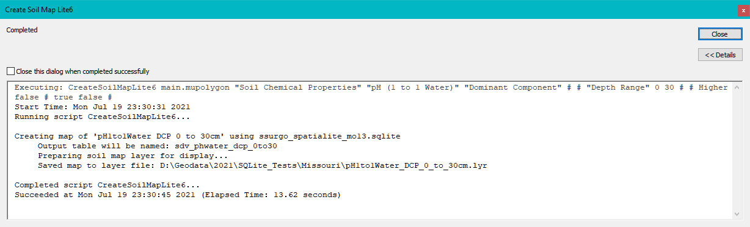
Two ArcTools are highlighted in this document: ‘Create Soil Map Lite’, ‘Create Soil Map Series Lite’. The rest of the toolbox has not been updated to work with SQLite.
A test database containing data for 14 Missouri soil survey areas was used to create the map layers shown on the following slides.
In this example, the tool was used to create a soil pH map for 14 soil survey areas. Similar to the gSSURGO version of the tool, a summary rating table was created and then a spatial view was created that joined the rating table to the ‘mupolygon’ layer. Unlike the gSSURGO version, the tool currently does not work with raster input layers.

Slide 6
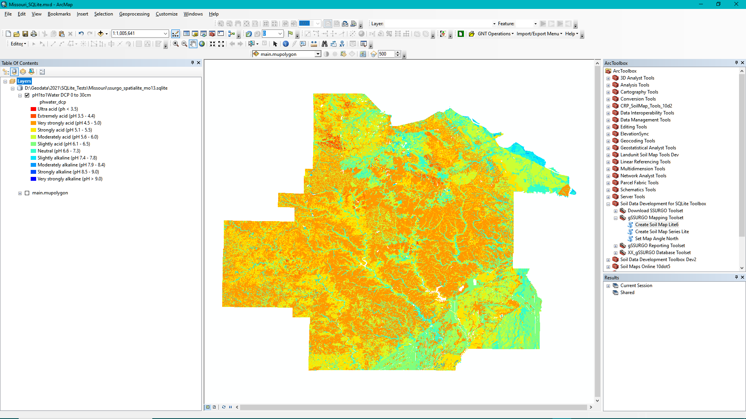
In this example, the pH soil map with complete symbology was created in about 14 seconds.

Slide 7
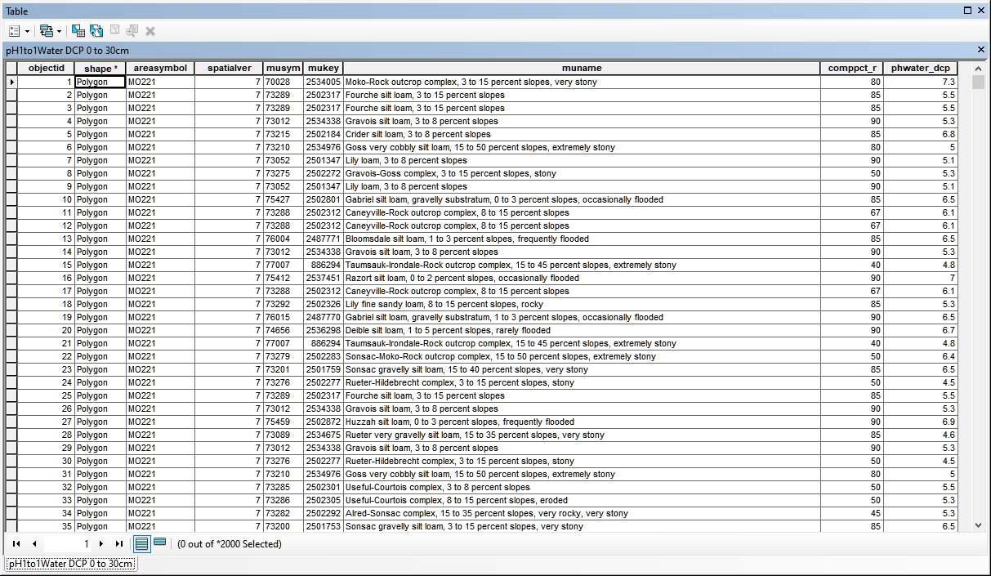
This is what the attribute table for the new pH soil map looks like…

Slide 8
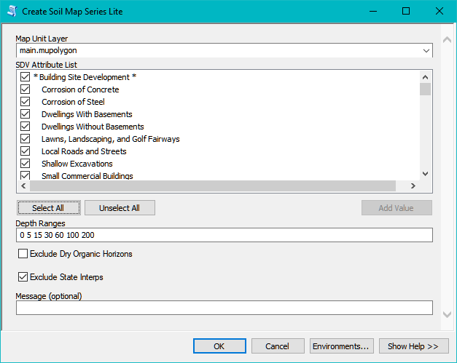
The ‘Create Soil Map Series Lite’ tool allows the user to automatically create a series of soil maps. In the following example, 286 soil maps were created in a little over 1 hour.

Slide 9
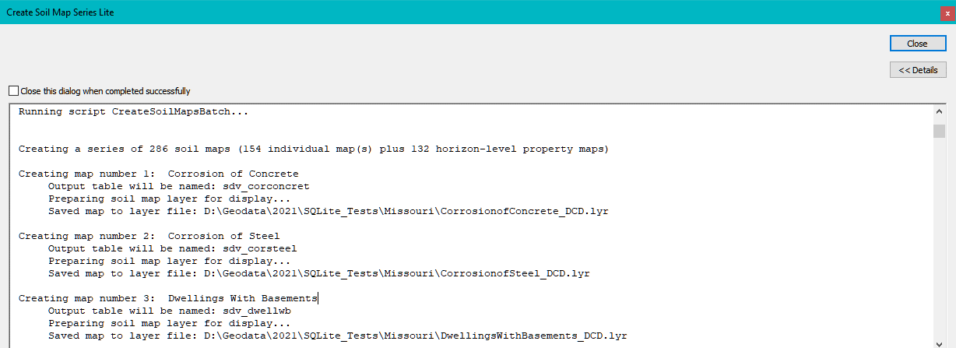
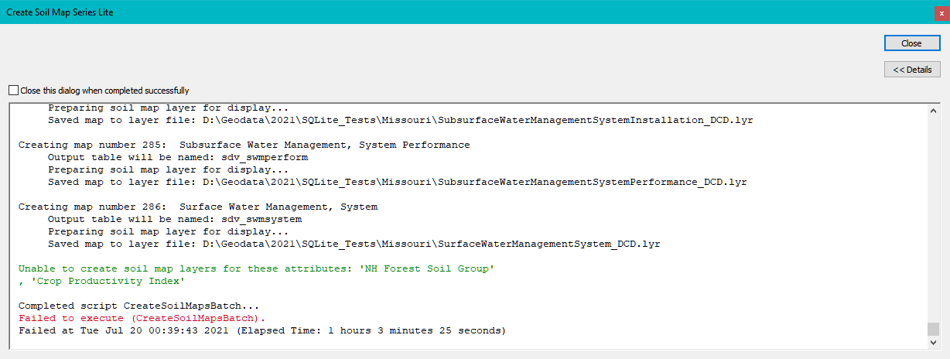

Slide 10
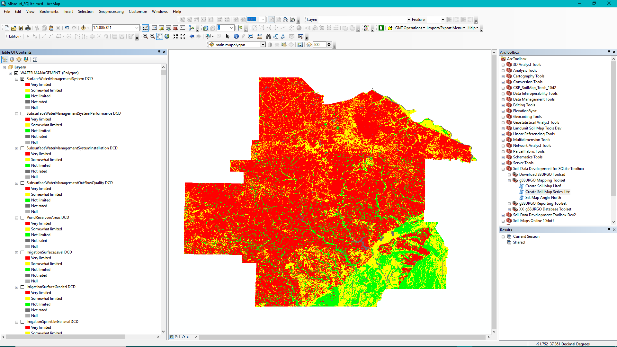
The ‘Create Soil Map Series Lite’ tool can group each set of soil maps using the Soil Data Viewer ‘folder’ name. Here each of the layers are under ‘WATER MANAGEMENT’.

Slide 11

Please note that the box for a group layer must be checked before individual map layers within the group can be displayed.

Slide 12
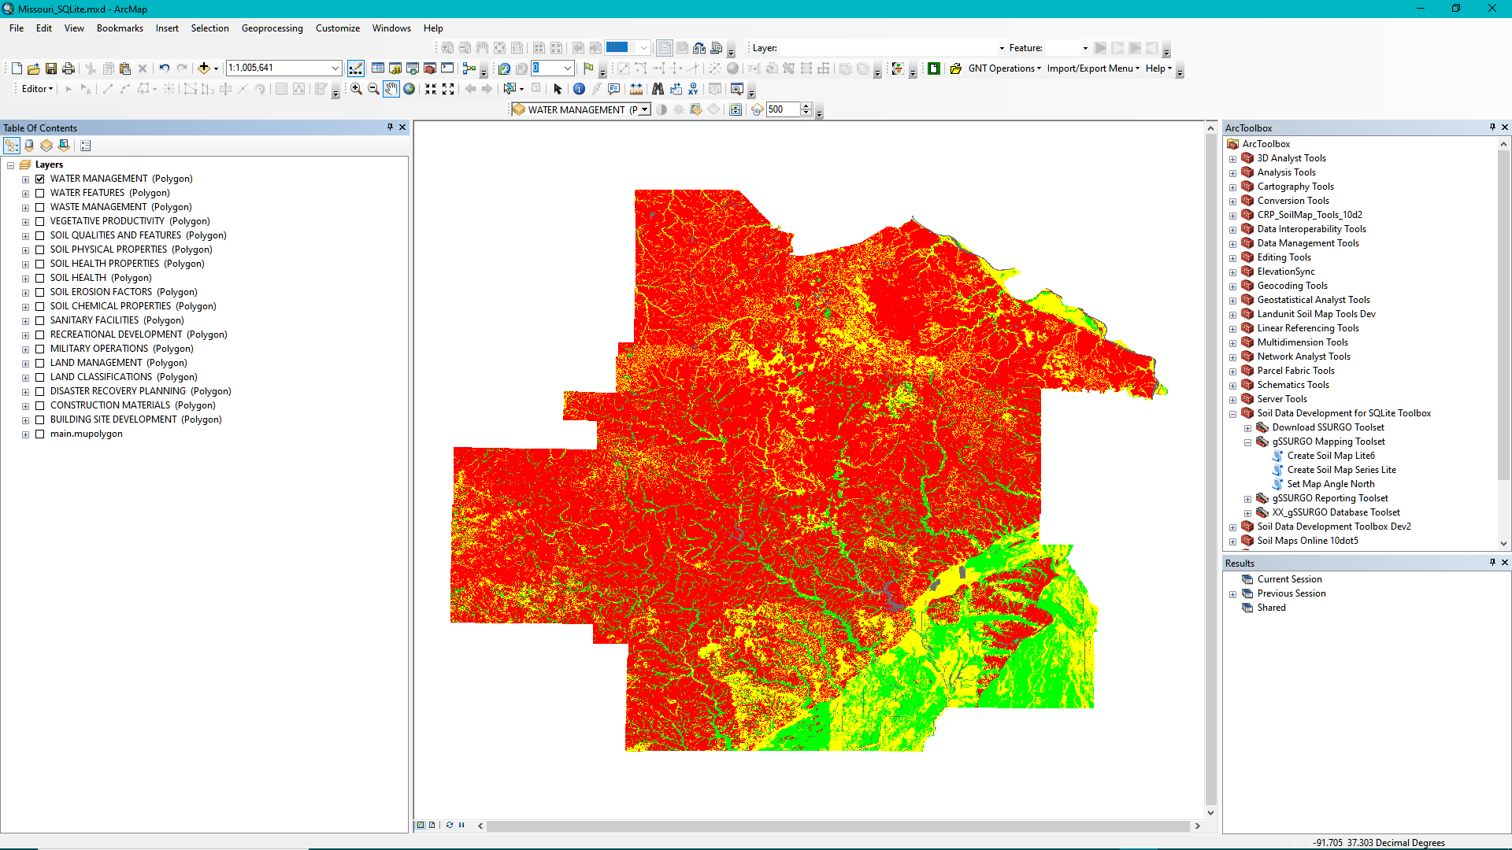
The layer listing in the ArcMap Table of Contents can be collapsed so that only the group layers are displayed, instead of the 286 individual map layers.

Slide 13
I would recommend that each SSURGO-SQLite database be kept in its own folder.
This will make it easier to organize map layer files that are created by the ‘Create Soil Map Lite’ tools and prevent them from being overwritten by layers created using other databases.
If the user keeps the layer (.lyr) files in the same folder as the source database, these layers can be added to other ArcMap projects or even to ArcGIS Pro projects. Each of the ‘group layers’ has its own layer file which allow the user to add multiple map layers at once. The layer files and database can also be moved to another location or computer as long as they are kept together.

